Slide 1
MAR 580: Models for Marine Ecosystem Based Management
Lecture 9
Qualitative Modeling
Model Structure Uncertainty
Acknowledgements: Robert Wildermuth
22 April 2016

Slide 2
Simplified Schedule
Week | Topic | Assignments
1/29 | Intro to EBM, review of fisheries assessment models
2/5 | No Class - weather
2/12 | Stock assessment models with ecosystem processes
2/19 | Guest lecture: Food web models I (Ecopath) | HWK 1 due
2/26 | Guest lecture: Food web models II (Ecosim) | Project outlines
3/ 4 | Multispecies models, estimating species interactions
3/11 | Marine spatial planning models, marine reserve design | HWK 2 due
3/18 | SPRING BREAK
3/25 | No Class - IMS Research Symposium (several mini-lectures) | HWK 3 due
4/1 | Valuation of ecosystem services
4/8 | No Class – Stock Synthesis training course | HWK 4 due
4/15 | Whole of system models, MSE for ecosystems
4/22 | Qualitative modeling, model structure uncertainty | HWK 5 due
4/29 | Participatory modeling, multicriteria decision analysis
5/6 | Final exam: Project Presentations | Final papers

Slide 3
Today’s Outline
Qualitative modeling for EBM
LAB
Loop analysis
Evaluate model structure uncertainty

Slide 4
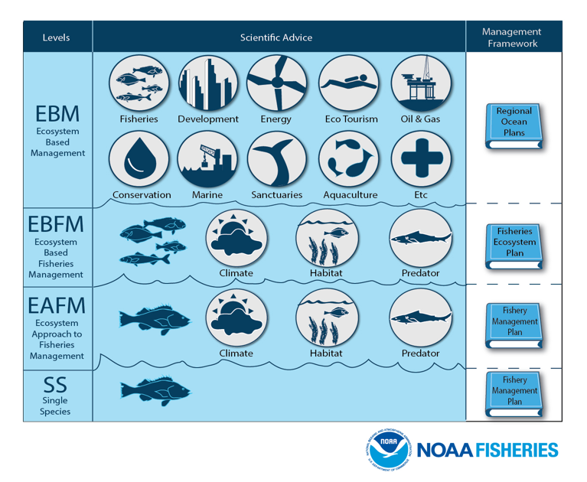

Slide 5
Why Qualitative models?
Development of models for complex systems is constrained by
data availability,
mechanistic understanding,
capacity and capability.
Desire tools for exploration of system structure and function without need for fine detail in functional representations or parameterization.
Advantages:
rapidly formulate ideas about system function,
capture feedback effects in qualitative predictions,
precursor to inform the development of more detailed quantitative models.

Slide 6
History of qualitative modeling
Originally developed by Levins (1974) and Puccia and Levins (1985)
formalized analysis of feedbacks in network models.
Broadly applied in ecology since, e.g.
develop hypotheses for species interactions (Dambacher et al. 1999),
explore life expectancy changes in perturbed communities (Dambacher et al. 2005),
determine indicators for exploited systems (Dambacher et al. 2009, Metcalf et al. 2011),
eradication scenarios for invasive species (Raymond et al. 2011),
alternative stable states in ecological systems (Marzloff et al. 2011),
Ecosystem impacts of aquaculture development (Reum et al. 2015a, 2015b)
Effect of eutrophication & crab management in coastal systems (Carey et al. 2014)
System effects of fisheries management strategies and climate change (DePiper et al. 2016, Tam et al. 2016, Wildermuth et al. 2016)
Methods for formal assessment of uncertainty in qualitative network models
Hosack et al. 2008
Melbourne-Thomas et al. 2012, 2014

Slide 7
(Main) Types of Qualitative methods
Loop analysis
Extension using simulation and Bayesian Belief Networks
Fuzzy cognitive mapping
Numerous software packages
e.g.
R: LoopAnalyst, Qpress
Mental Modeler (FCM)

Slide 8
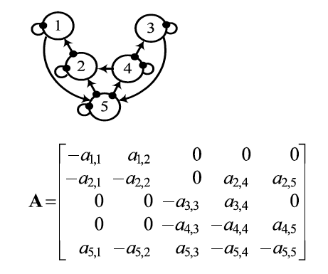
Signed digraphs to community matrix
Dambacher et al. 2003
Effect of species 2 on species 1
All species here have
negative impact on themselves
e.g. density dependence
Interaction terms among species can be hard to estimate, are often result of several processes.
Solution: Replace elements of community matrix with symbolic notation of direction of effect.

Slide 9
Model Structure Uncertainty
Both nature (the signs [positive, negative, or zero]) and strength (i.e., the magnitudes) of a_{ij} interactions between populations may be uncertain.
(1) relates to model structure uncertainty,
(2) can be thought of as a parameterization problem.
Qualitative modeling focuses on (1) by specifying only the signs of the interaction coefficients of community matrix.
Seeks only qualitative predictions of the system’s response to a perturbation.

Slide 10
Qualitative ‘loop’ analysis
Complementary feedback cycles
The computations required in the qualitative assessment of system response to perturbation are based upon feedback ‘loops’ or cycles.
Stability of the equilibrium is characterized by the eigenvalues of the community matrix;
if all eigenvalues of A have negative real part, the equilibrium is stable.
Importantly, the response of the system to a press perturbation, can be determined from the inverse community matrix A.

Slide 11
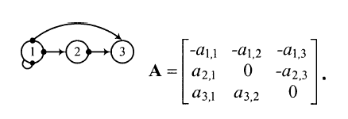
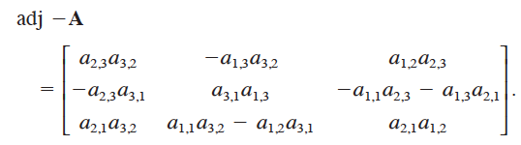
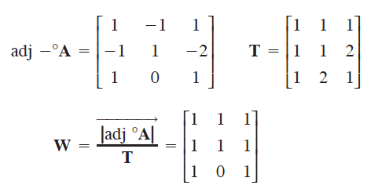
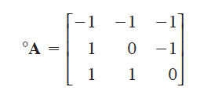
Net feedbacks on system components associated with positive change in columns.
Total # of loops

Slide 12
Adjoint matrix gives response to perturbations
Frame management actions as press perturbations.
Loop analysis can be used to strategically examine a foodweb’s response and provide system-wide understanding.
e.g. Carey et al. (2014) added EBM component as an additional variable with interactions on managed species / components.

Slide 13
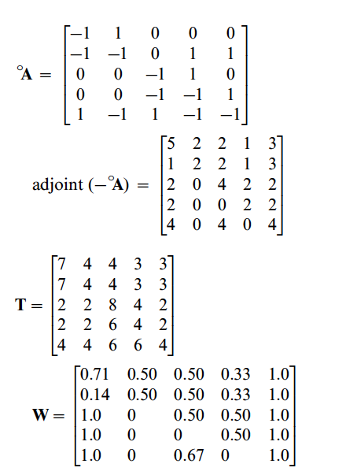
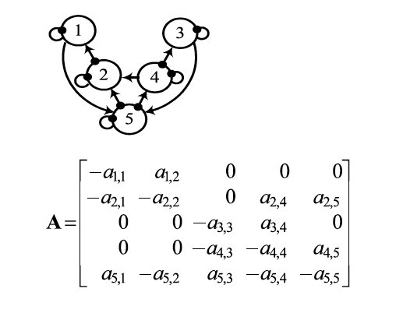
Prediction weights
Prediction weights

Slide 14
Uncertainty in Response & Model Structure
Qualitative predictions can be ambiguous due to both positive and negative feedback effects.
Development of ‘‘prediction weights’’ (derived from ratios of feedback cycles).
Use of simulation, where linkages are assigned random interaction strengths:
Outcomes used to verify prediction weightings
Aggregated from multiple random assignments of interaction strengths (as in Raymond et al. 2011).

Slide 15
Alternatives to model structure uncertainty
Use a representative set of models that captures alternative versions of our understanding of the interactions within the system.
Each model within the set is structurally unambiguous
Use a single overarching model structure that includes one or more linkages that are marked as ‘‘uncertain.’’
Can expand to set of unambiguous models by including or excluding uncertain linkages.

Slide 16
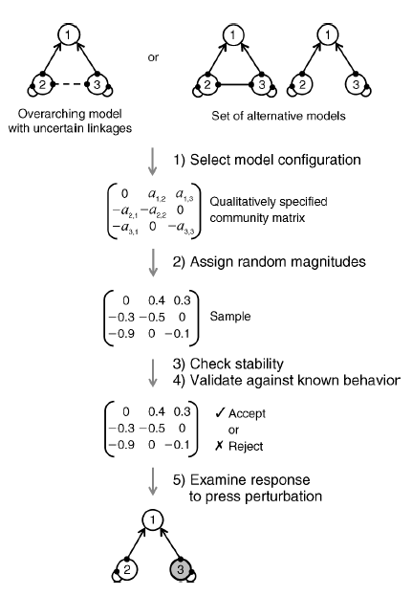
Simulation approach to qualitative modeling
Melbourne-Thomas et al. (2012)
Enables calculation of response probabilities without enumerating T matrix.

Slide 17
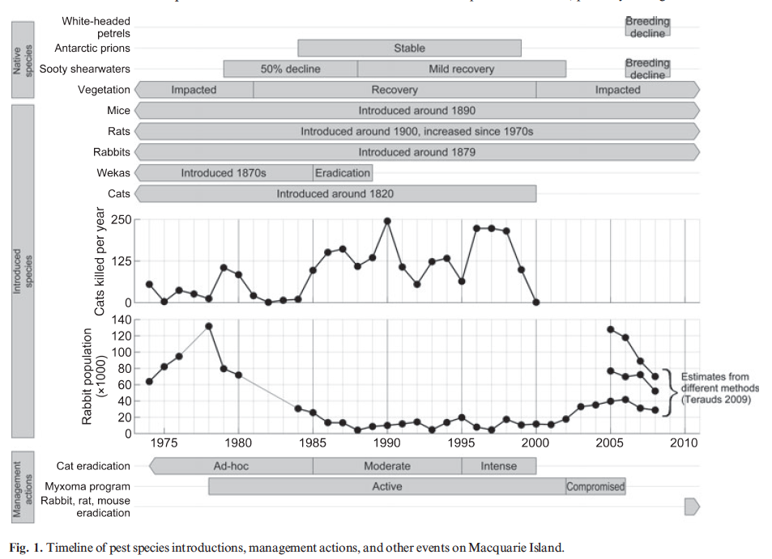
here

Slide 18
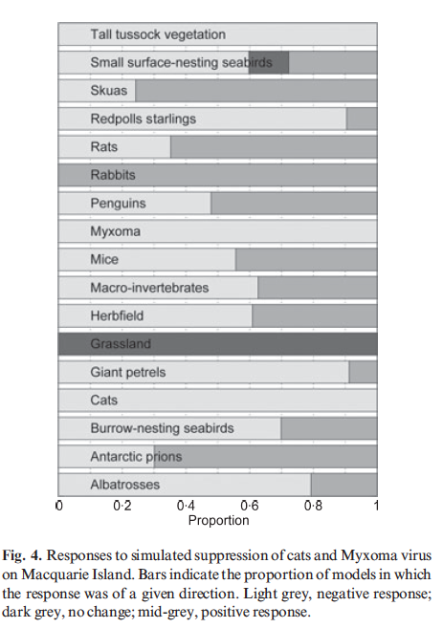
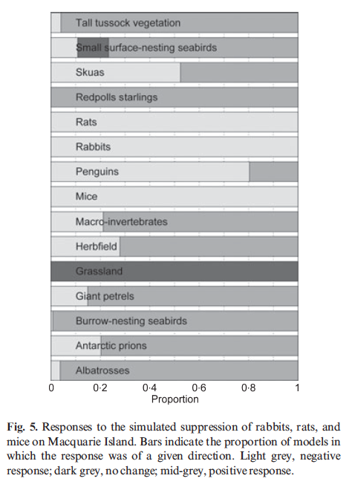
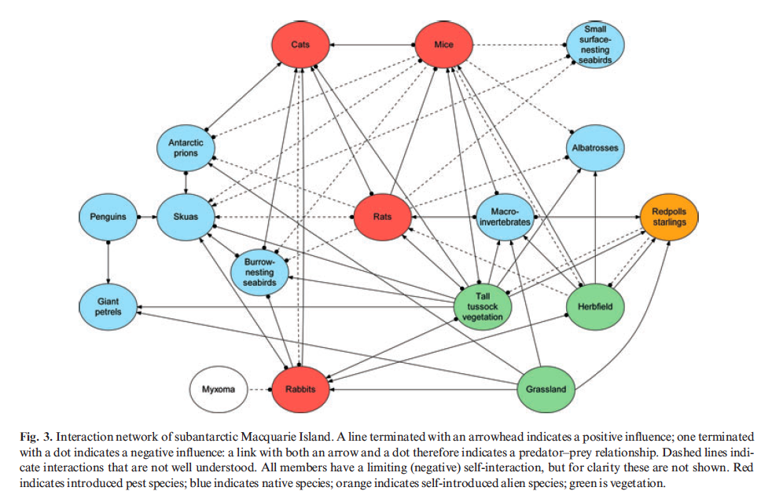
Macquarie island network
Raymond et al. 2011

Slide 19
Challenges
All-or-none aspect of predictions.
Can be accommodated using simulation of weights or via Bayesian networking
Loop algorithm relies upon graphical interpretation of signed digraph models.
For large or complex systems (i.e. high connectance), signed digraph analysis grows factorially.
Hence use of simulations to evalaute probabilities of responses.

Slide 20
Take home messages
Loop analysis can be a useful tool for informing EBM especially in situations with limited data.
May best be viewed as a screening tool before testing hypotheses with
more detailed models,
field or laboratory experiments,
long-term monitoring.
Forces simplification – can lead to model predictability and accessibility at the expense of resolution
Ecosystem simulation models (e.g. EwE) require extensive data on species and interactions.
comparisons among systems may be limited because similar levels of data are not collected in all systems.
Predictions from loop analysis can be monitored and used in an adaptive management framework, and suggest research gaps (Lester et al., 2010; Link, 2010).

Slide 21
Additional resources
Qpress R package
http://github.com/SWotherspoon/QPress
‘Loop Group’ (Oregon State Univ)
http://ipmnet.org/loop/
Lots of example foodweb matrices
Java software

Slide 22
Next time on Models for Marine EBM….
(April 29)
Participatory Modeling
Multi-Criteria Decision Analysis
(May 5)
Project presentations

Slide 23
Questions?

Slide 24
Lab Example
Draw a signed digraph of a Social Ecological System containing the following components:
Phytoplankton
Zooplankton
Fish
Fishery
Seabird
Coastal habitat
Manager

Slide 25
-
-
+
Seabird
Manager
Now turn this into matrix form!
-
-
+/-
-
Fishery
+/-
Fish
-
-
Zooplankton
-
Coastal Habitat
Phytoplankton
-

